Slide 1
CNOS PROJECT
Designing a computer network for Ceplenița commune
Guiding teacher:Daniel Mătăsaru
Project team:
Covașă Mihai Șerban Vlad
Group 5311

Slide 2
Project overview
We have decided to implement the computer network for Ceplenita commune. Our project would serve high quality internet to 4 villages from which 983 different households, a considerable number of public institutions such as the Ceplenița City Hall, Ceplenița Public Library, 4 schools, 4 kindergartens, one police station and more than 10 private companies. Out of these we have focused on the layout of the Ceplenita City Hall. It has one floor but multiple devices connected to its network such as personal computers, mobile phones, a projector, wireless access point and servers. For each department a separate vlan is used.

Slide 3
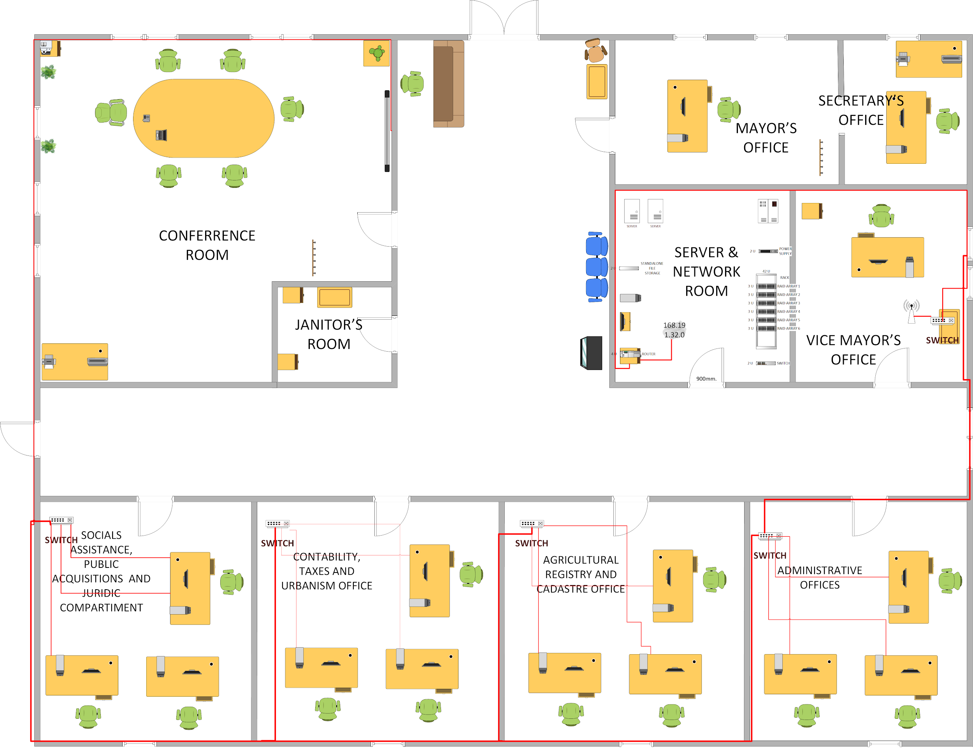
Ceplenița City Hall building plan

Slide 4
Analysis of the subnetworks
The subnet mask is 55.255.252.0 or 1111 1111.1111 1111.1111 1100.0000 0000 /22
Subnetwork | ID Subnetwork | IP address subnetwork
#0 | 000000 | 1010 1000 . 1011 1111 . 000000 00. 0000 0000
#1 | 000001 | 1010 1000 . 1011 1111 . 000001 00. 0000 0000
... | … | …
#25 | 011001 | 1010 1000 . 1011 1111 . 011001 00. 0000 0000
…
#63 | 111111 | 1010 1000 . 1011 1111 .111111 00. 0000 0000
Class B: 255.255.252.0
Chosen IP 168.191.0.0 / 1010 1000 . 1011 1111 . 0 . 0
#0-#63 = 64 subnetworks available (required 26)
IP range: 168.191.0.0-168.191.252.0

Slide 5
Hosts range
2^10-2=1024-2=1022 hosts Binary IP address: 10101000.10111111.000000 00.0000 0000
Subnetwork | Subnetwork IP | Domain Address | Broadcast Address
#0 | 168.191.0.0 | 168.191.0.1-168.191.3.254 | 168.191.3.255
#1 | 168.191.4.0 | 168.191.4.1-168.191.7.254 | 168.191.7.255
#2 | 168.191.8.0 | 168.191.8.1-168.191.11.254 | 168.191.11.255
#3 | 168.191.12.0 | 168.191.12.1-168.191.15.254 | 168.191.15.255
#4 | 168.191.16.0 | 168.191.16.1-168.191.19.254 | 168.191.19.255
#5 | 168.191.20.0 | 168.191.20.1-168.191.23.254 | 168.191.23.255
… | … | … | …
#25 | 168.191.100.0 | 168.191.100.1-168.191.103.254 | 168.191.103.255
… | … | … | …
#63 | 168.191.252.0 | 168.191.252.1-168.191.255.254 | 168.191.255.255

Slide 6
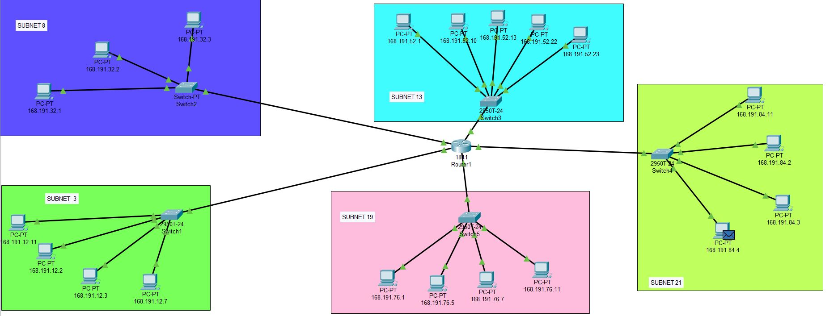
Implementing the subnets in CISCO PACKET TRACER

Slide 7
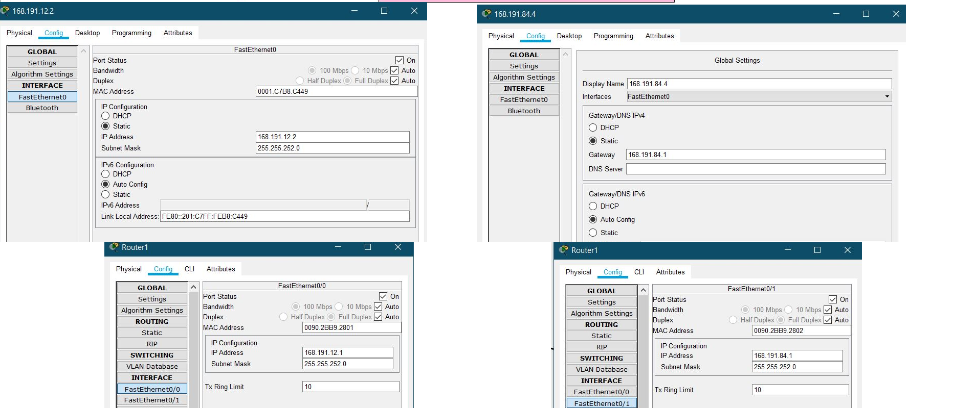
The configuration of 2 PCs and the router

Slide 8
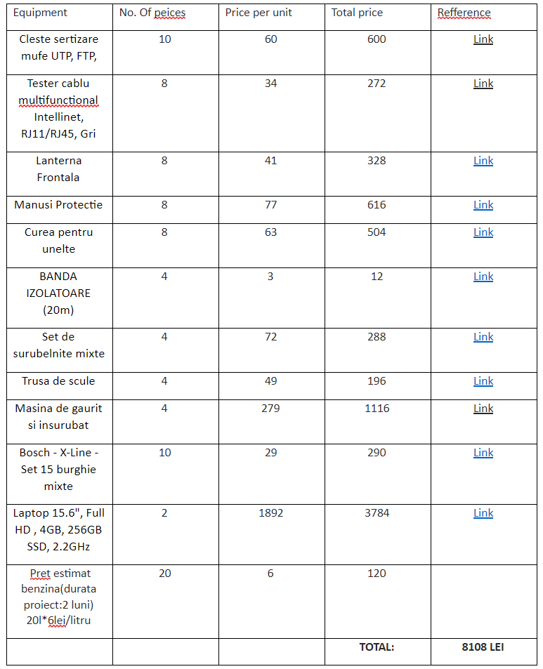
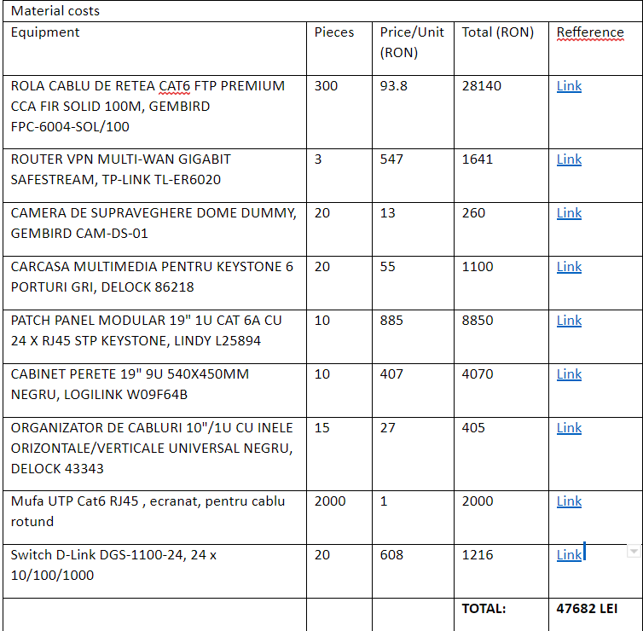
Bill of materials and costs
Logistics costs

Slide 9
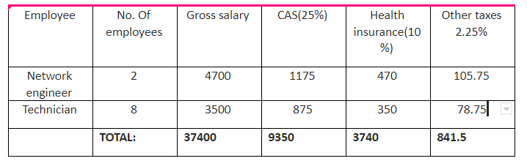
Human resources and project length
Net salary:
Network engineer: 2749 RON
Technician: 2052 RON
Estimated Time: 2 (Months)
No. of 10 employees

Slide 10
Total costs
Manual labor: 38241.5 LEI
Equipment costs: 47682 lei
Logistics: 10/100*(Manual labor+Equipment costs)= 8592.35 lei
Profit(25% of A+B+10%*C): 23628.96 lei
Profit tax(16%): 3780.63 lei
Project Costs(TOTAL): 121871.45 lei

